Slide 1

Puberty
Year 7 Health – 2024
Lesson 6

Slide 2
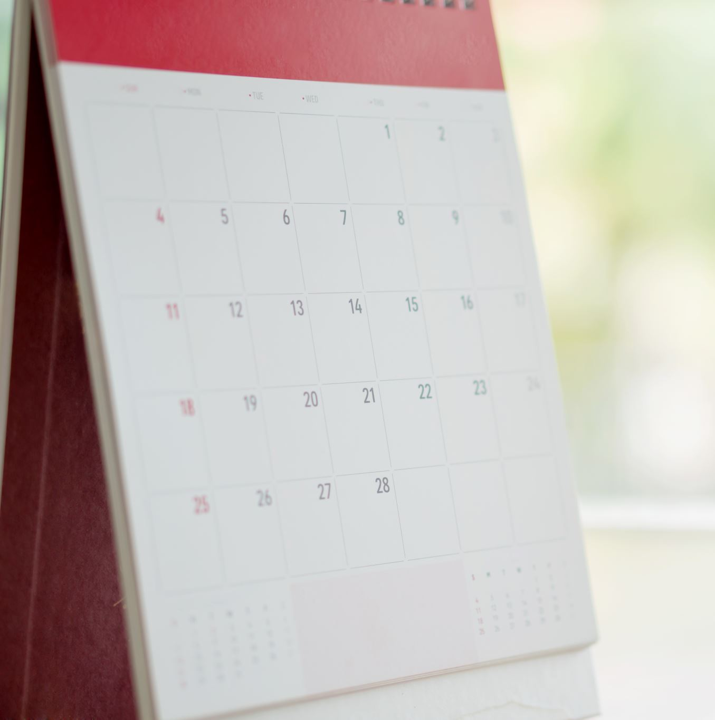
Today’s focus
Label the female reproductive system.
Define the different parts of the female reproductive system.
Describe menstruation and ovulation.

Slide 3

(pg. 49)
In the first 5 minutes of each lesson, you will complete your revision page, you will find these throughout your booklet.
The revision page consists of three questions. It will need to be completed in detail. One-word answers will not be accepted.
The three questions :
What two concepts or ideas did I learn in class last week?
What did I find interesting about last week’s lesson? Provide a specific example.
Any questions or new words you have learnt?
The teacher will go over this each lesson with you to see what you have learnt. It is a great way for you to revisit content and test your memory.

Slide 4
HOOK: Quick quiz
QUESTIONS:
What is the primary MALE sex hormone?
What is the primary FEMALE sex hormone?
List 2 parts of the MALE reproductive system
List 2 parts of the FEMALE reproductive system
What is 1 emotional change that occurs during puberty?
What is the purpose of puberty?
What are hormones?
A question will be read aloud.
If you think you know the answer, raise your hand.
A person who has their hand up will be chosen at random to answer.
  A new person will be selected if the answer is incorrect.
  Keep your hand up if your answer was correct.
  Lower your hand if your answer was incorrect.
Notes:
OPTIONAL HOOK #1
RELEVANT TO TEST
ANSWERS:
What is the primary MALE sex hormone?
Testosterone
What is the primary FEMALE sex hormone?
Oestrogen
List 2 parts of the MALE reproductive system
Testes, penis, prostate gland, seminal vesicle, epididymis, vas deferens
List 2 parts of the FEMALE reproductive system
Ovaries, vagina, fallopian tubes, uterus
What is 1 emotional change that occurs during puberty?
Romantic feelings towards others, changes in self-confidence and self-esteem, may feel self-conscious about our body and appearance, want to challenge authority/rebel, want to have new experiences etc.
What is the purpose of puberty?
To become capable of reproduction
What are hormones?
Chemical messengers that tell our body what to do

Slide 5
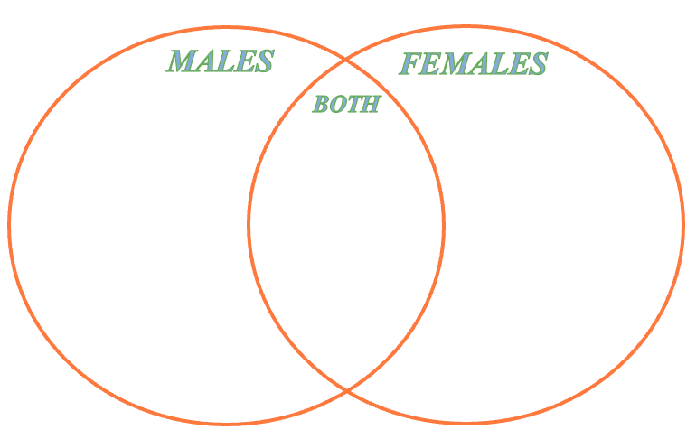
Activity 1: CHANGES RECAP (pg.50)
Complete the Venn diagram outlining some of the changes that occur during puberty.
Distinguish the changes that occur to males,
females and both.
You can work with those around you,
and you can refer to your work from
previous lessons if you need help.
Consider PHYSICAL, SOCIAL & EMOTIONAL
changes that occur during puberty.
You have 5 minutes ONLY.
Notes:
OPTIONAL HOOK #2 / CHANGES ARE RELEVANT TO TEST
This activity is purely a recap. 5 minutes only.
Can award a prize for the student(s) who have the most answers written down.
Up to the teacher if you would like students to complete activity individually or in pairs/groups.

Slide 6
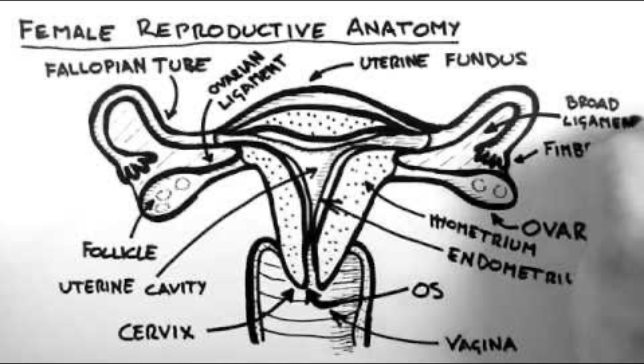
Notes:
Start at 0:28sec
4:45mins
https://www.youtube.com/watch?v=toKp0SGyv5w

Slide 7
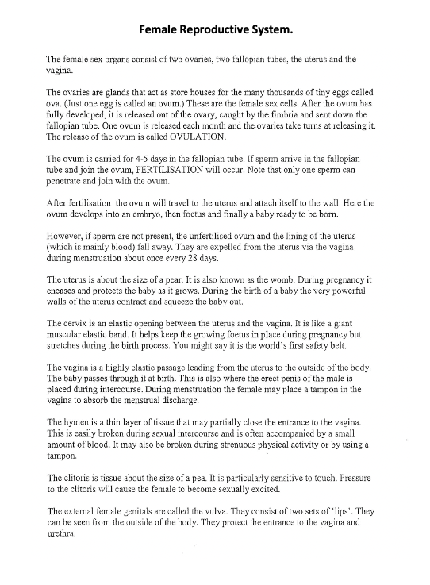
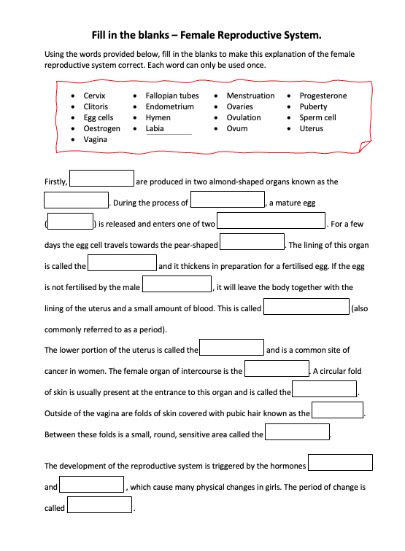
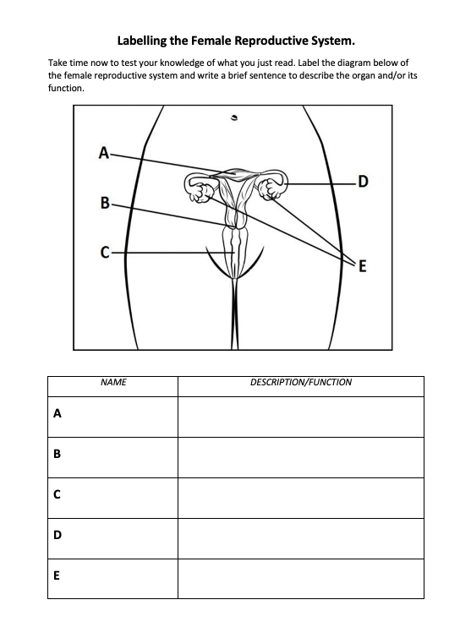
Activity 2: (pg.51-53)
Female Reproductive System
Read the information about the female reproductive system on pg.51.
Use that information to help you fill in the blanks on pg.52.
Test your knowledge and have a go at labelling the female reproductive system image on pg.53 and fill in the function/description of each.
You have 12 minutes.
Notes:
RELEVANT TO TEST
ALTERNATIVE:
- read pg___ as a class and fill in the gaps together.
Go over answers as a class.

Slide 8
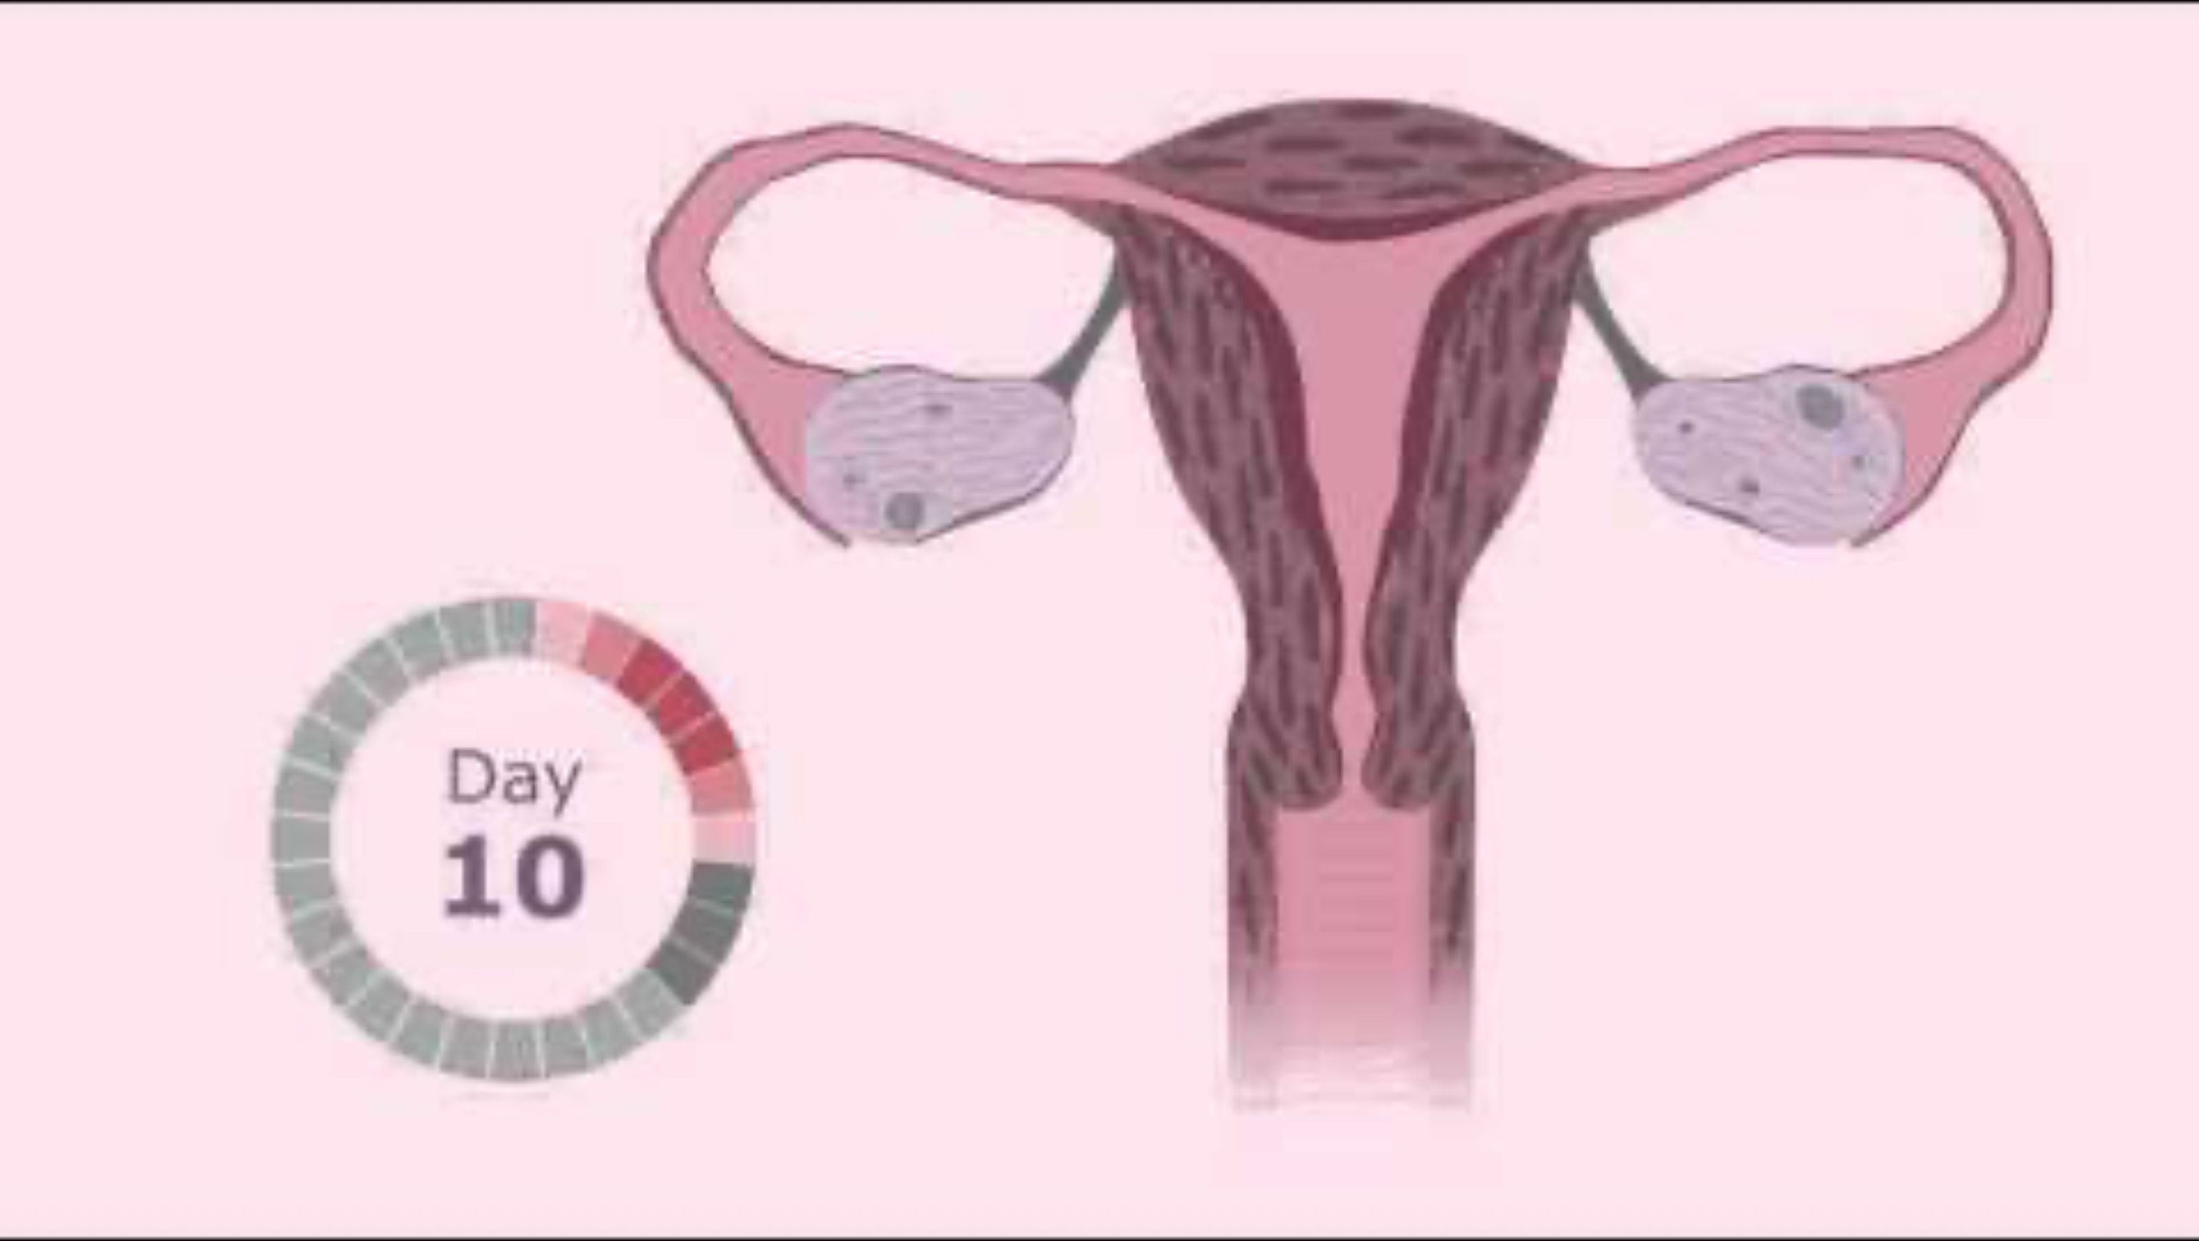
Notes:
2:05min
https://www.youtube.com/watch?v=vXrQ_FhZmos&t=5s

Slide 9
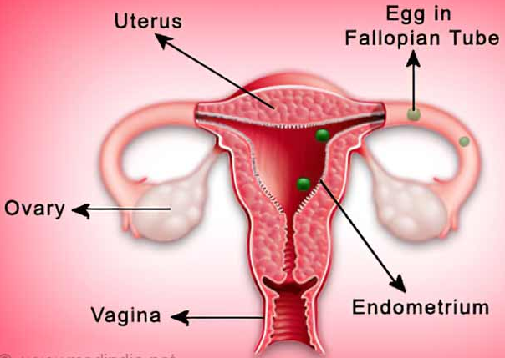
Ovulation (pg.54)
Girls are born with hundreds of tiny eggs. One egg is called an ovum, multiple eggs are called ova.
They mature and develop in the ovaries
(singular = ovary).
At puberty, hormones tell the ovaries that it’s
time to start releasing ova/eggs.
Usually, one egg at a time matures (develops) and
is released from an ovary.
This release of the ovum from the ovary is
called ovulation.
Ovulation occurs on average once a month.
Notes:
RELEVANT TO TEST
Fill in the blanks.

Slide 10
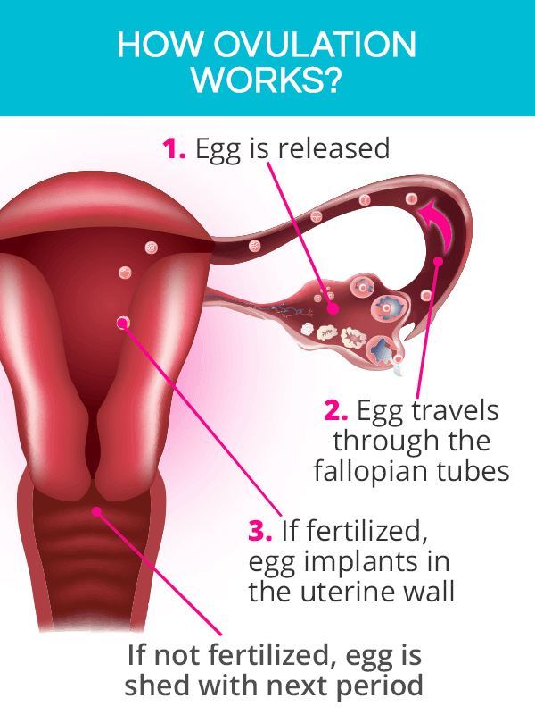
Ovulation continued… (pg.54)
At the same time, the uterus starts to grow a
thick lining on the inside wall.
This uterine lining is called the endometrium.
  The endometrium/uterine lining has
  lots of tiny blood vessels.
  The lining is there to protect and feed
  an ovum that has combined with a sperm
  to form a fertilised egg.
Notes:
RELEVANT TO TEST
Fill in the blanks.

Slide 11
MENSTRUATION (pg.55)
If an ovum/egg does not meet a sperm, the endometrium (lining of the uterus) is not needed.
  It breaks up – mixed with some blood, it comes out of the uterus, through the vagina and then out of the body through the vaginal opening.
This process is called menstruation.
  It is also commonly referred to as a period.
If a woman is not pregnant, then her ovary will continue to release an ovum, the endometrium will build up and she will have her period. This will continue to occur if the egg is not fertilised.
The repetition of this cycle is called the menstrual cycle. On average it occurs every 28 days.
Notes:
RELEVANT TO TEST
Fill in the blanks.

Slide 12
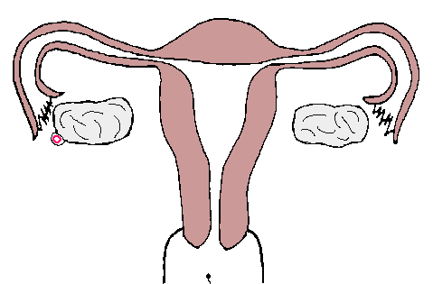
FERTILISATION/CONCEPTION (pg.55)
BONUS QUESTION!
Q: How many sperm does it take to fertilise an egg?
If a sperm fertilises an egg:
If an ovum is successfully fertilised by a sperm, this occurs in the fallopian tube. The fertilised ovum will move and begin to implant into the lining of the uterus – the endometrium.
  The process of a sperm fertilising an egg/ovum is called conception.
The endometrium provides the fertilised egg with the environment that it needs to develop into a baby.
Approximately 9 months later a baby will be ready to be born.
A: only ONE!
Q: What about in the case of multiple births?
i.e., twins and triplets etc.
identical and fraternal.
A:
Identical twins = one sperm with one egg that split.
Fraternal twins = two eggs, two sperm (one sperm per egg)
Notes:
RELEVANT TO TEST
Fill in the blanks.

Slide 13
The menstrual cycle
Most girls get their period when they are between 10 – 15 years old.
  The average age is 12, but it is not uncommon for girls to begin their period earlier or later than this.
The length of the menstrual cycle varies from person to person, but on average a woman will have her period every 28 days.
Regular cycles that are 23-35 days in length can be normal, if that is what is regular and normal for the female.
It is important to note that all girls will have different experiences with their period – just like with everything else about puberty, no two people are the exact same.
Notes:
RELEVANT TO TEST
Discuss – Information is not in their books. They could add it to the ‘additional notes’ section on the bottom of page 56.

Slide 14
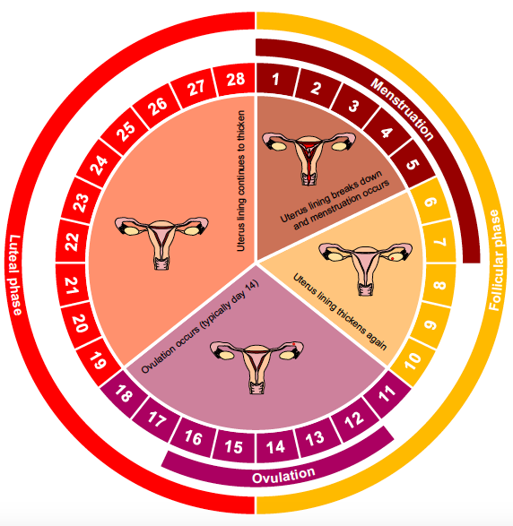
Menstrual Cycle (pg.56)
The menstrual cycle occurs monthly if an egg is not fertilised and pregnancy does not occur.
It comprises of different phases:
  Follicular Phase
    Occurs from day 1 – 14
  Luteal Phase
    Occurs from day 15 – 28
  Menstruation
    Occurs during days 1 – 7
  Ovulation
    Occurs during days 12 – 16
Notes:
Explain the phases and what occurs during each phase.
Diagram is also in their books.

Slide 15

GLOSSARY: (Pg. 5)
At the front of your books is your glossary. Turn to your glossary and add the following words and their definitions:
Menstruation
  The normal vaginal bleeding that occurs as part of a woman's monthly cycle.
  Each month a woman’s body prepares for pregnancy. If this does not occur, they have their period.
Ovulation
  The phase of the female menstrual cycle that involves the release of an egg (ovum) from one of the ovaries.
Ovum
  The female sex cell (also known as the egg) formed in the ovaries and contains the female DNA.
  Ovum = singular.
  Ova = plural.

Slide 16
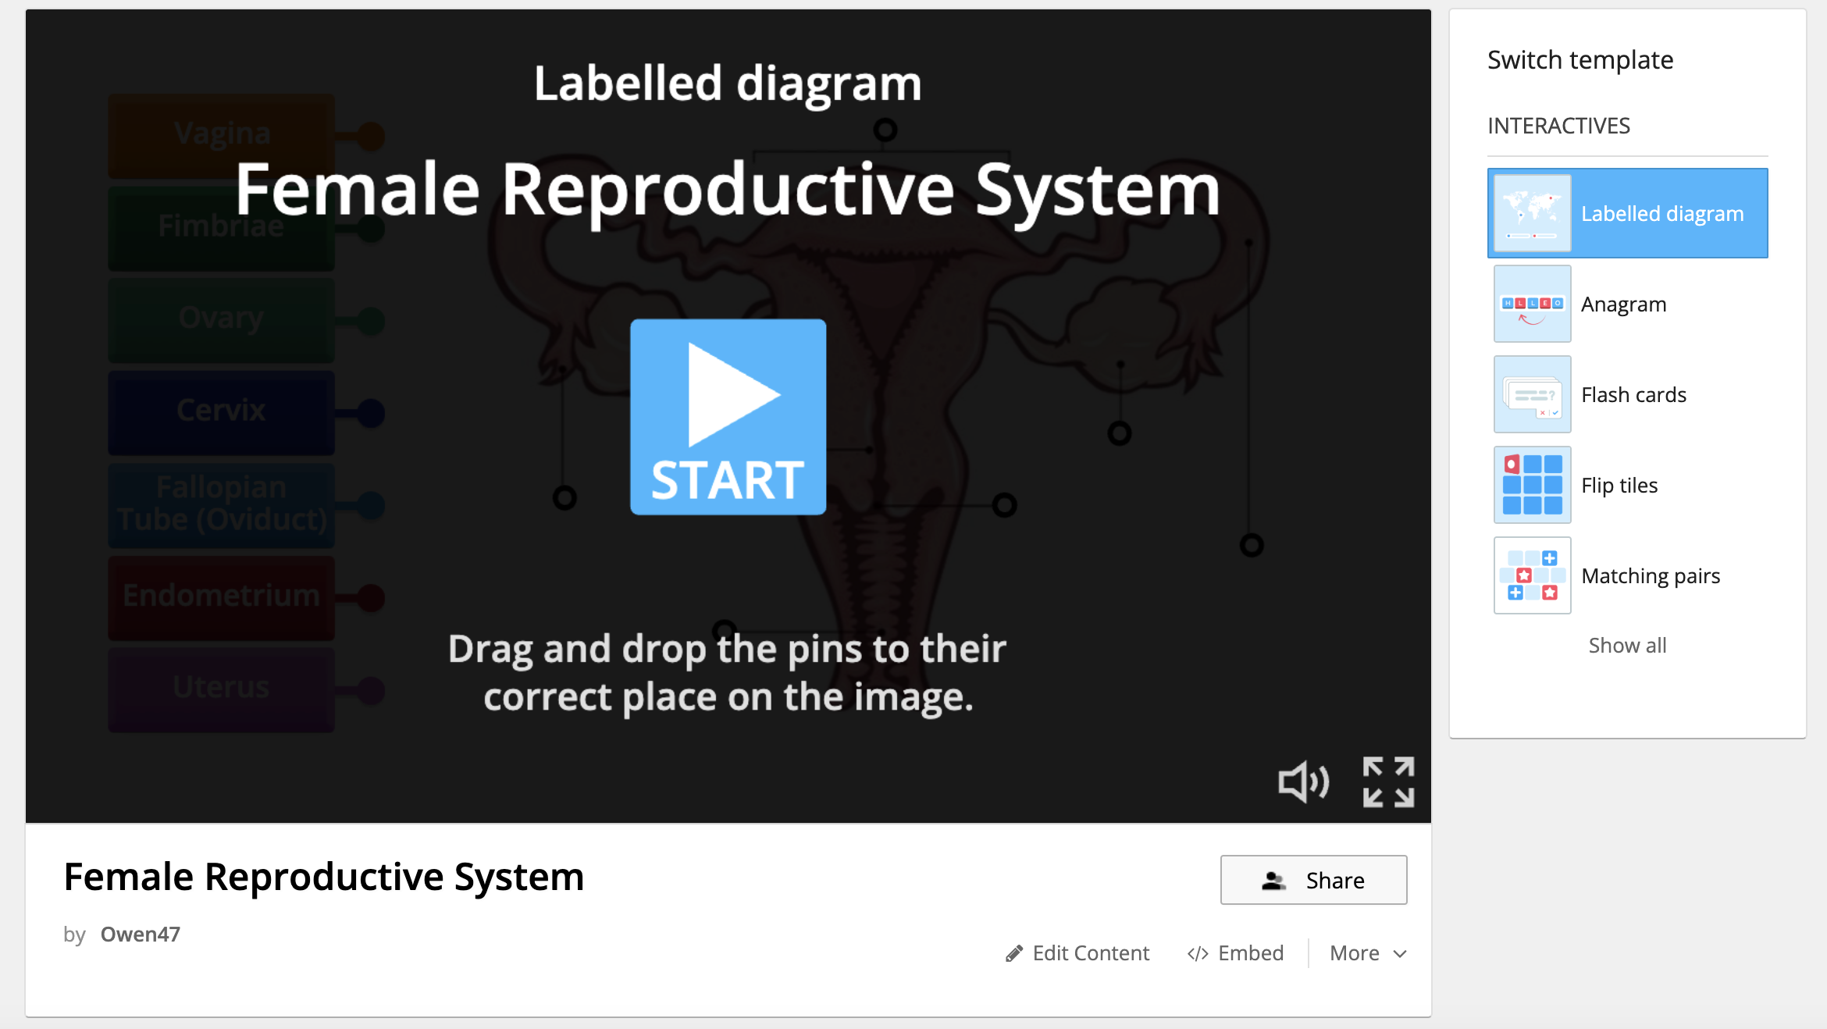
Activity 3: REFLECTION
Test your knowledge… (pg.56)
Visit:
https://wordwall.net/resource/27628547
Complete the activity to label the diagram of the female reproductive system.
Once you have completed the diagram activity, complete the anagram activity.
You have 5 minutes to have a go at these activities.
Notes:
OPTIONAL
Link is also in their books to click on.
https://wordwall.net/resource/27628547

